Slide 1
CSI342 Systems Analysis and Design
Lecture 4 – Requirements Engineering

Slide 2
Learning Objectives
After this chapter, you will be able to:
Explain system requirements
Compare and contrast functional and non-functional requirements
Explain how to validate and verify requirements
Discuss fact-finding techniques used in gathering requirements

Slide 3
Overview of the Analysis Phase
Goal is to develop a clear understanding of the new system’s requirements
Understand the “As-Is” system
Identify Improvements
Develop the “To-Be” system concept
Use critical thinking skills to determine the true causes of problems
Apply knowledge of IS and business to outline ways to solve the problems in the new system

Slide 4
What is a Requirement?
A statement of what the system must do; or a statement of characteristics the system must have.
Types of requirements: classified according to characteristics
what the business needs (business requirements)
what the users need to do (user requirements)
what the software should do (functional requirements)
characteristics the system should have (nonfunctional requirements)
how the system should be built (system requirements).

Slide 5
REQUIREMENTS MODELING
involves fact-finding to describe the current system and identification of the requirements for the new system, such as outputs, inputs, processes, performance, and security.

Slide 6
REQUIREMENTS MODELING
System requirements fall into five general categories:
Output refers to electronic or printed information produced by the system.
Input refers to necessary data that enters the system, either manually or in an automated manner.
Process refers to the logical rules that are applied to transform the data into meaningful information.
Performance refers to system characteristics, such as speed, volume, capacity, availability, and reliability.
Control refers to hardware, software, and procedural controls that safeguard and protect the system and its data from internal or external threats.

Slide 7
Additional considerations
Scalability: ability to handle increased business volume and transactions
Security: make systems harder to infiltrate
Total cost of ownership: direct and indirect costs

Slide 8
System Requirements
Feature that must be included in an information system to satisfy business requirements
Requirements engineering activities
Gathering requirements
Representing requirements
Validating and verifying requirements

Slide 9
Gathering Requirements
First step in requirements engineering process
Requirements elicitation or fact-finding
Fact-finding involves answers to five familiar questions: who, what, where, when, and how
For each of those questions, one also must ask another very important question: why. Some examples of these questions are:

Slide 10
Gathering Requirements
Who? Who performs each of the procedures within the system? Why? Are the correct people performing the activity? Could other people perform the tasks more effectively?
What? What is being done? What procedures are being followed? Why is that process necessary? Often, procedures are followed for many years and no one knows why. Question why a procedure is being followed at all.
Where? Where are operations being performed? Why? Where could they be performed? Could they be performed more efficiently elsewhere?
When? When is a procedure performed? Why is it being performed at this time? Is this the best time?
How? How is a procedure performed? Why is it performed in that manner? Could it be performed better, more efficiently, or less expensively in some other manner?

Slide 11
Types of Requirements
Functional Requirements
A process the system should perform as a part of supporting a user task, or
Information the system should provide as the user performs a task
Specify the support the system will provide to the user in fulfilling his/her work tasks

Slide 12
More on Functional Requirements
Functional Requirement | Description | Examples
Process-oriented | A process the system must perform; a process the system must do | The system must allow registered customers to review their own order history for the past 3 years. The system must check incoming customer orders for inventory availability. The system should allow students to view a course schedule while registering for classes.
Information-oriented | Information the system must contain | The system must retain customer order history for 3 years. The system must include real-time inventory levels at all warehouses. The system must include budgeted and actual sales and expense amounts for the current year and 3 previous years.

Slide 13
Non-functional Requirements
Behavioral properties the system must have
Operational – physical and technical operating environment
Performance – speed, capacity, and reliability needs
Security – access restrictions, needed safeguards
Cultural and political – issues that will affect the final system

Slide 14
More on Nonfunctional Requirements (1 of 2)
Nonfunctional Requirement | Description | Examples
Operational | The physical and technical environments in which the system will operate | The system will run on Andriod mobile devices. The system should be able to integrate with the existing inventory system. The system should be compatible with any Web browser.
Performance | The speed, capacity, and reliability of the system | Any interaction between the user and the system should not exceed 2 seconds. The system downloads new status parameters within 5 minutes of a change. The system should be available for use 24 hours per day, 365 days per year. The system supports 300 simultaneous users from 9–11 a.m.; 150 simultaneous users at all other times.

Slide 15
More on Nonfunctional Requirements (2 of 2)
Nonfunctional Requirement | Description | Examples
Security | Who has authorized access to the system under what circumstances | Only direct managers can see staff personnel records. Technicians can see only their own work assignments. The system includes all available safeguards from viruses, worms, Trojan horses, etc.
Cultural and Political | Cultural and political factors and legal requirements that affect the system | The system should be able to distinguish between US currency and currency from other nations. Company policy is to buy computers only from Dell. Country managers are permitted to authorize custom user interfaces within their units. Personal information is protected in compliance with the Data Protection Act.

Slide 16
Representing Requirements (1 of 5)
Principles for documentation
Record information as soon as it is obtained
Use the simplest recording method
Record findings in a way that they can be understood by someone else
Organize documentation so related material is located easily

Slide 17
Representing Requirements (2 of 5)
Natural language
Vast majority of requirements are represented using unstructured natural language
Diagrams
Graphical methods and nontechnical language that represent the system at various stages
Use Cases
A Use Case represents a discrete unit of interaction between a user (human or machine) and the system. This interaction.
Functional decomposition diagrams
Top-down representation of a function or process

Slide 18
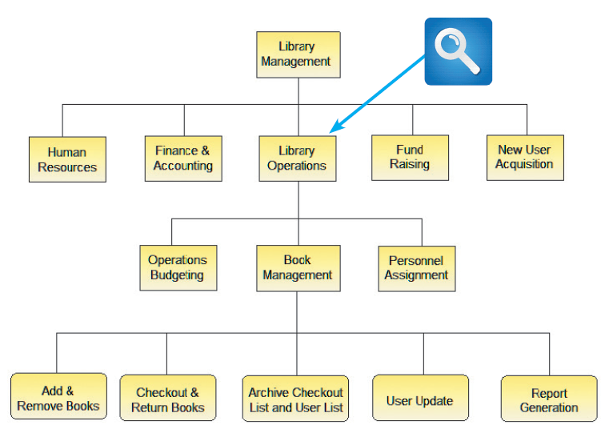
Representing Requirements (3 of 5)

Slide 19
Representing Requirements (4 of 5)
Business process diagrams
Represent one or more business processes
Business process modeling notation (BPMN) includes various shapes and symbols to represent events, processes, and workflows
Data flow diagrams
Show how the system stores, processes, and transforms data
Models
Provide a more formal representation of system requirements
Unified Modeling Language (UML)

Slide 20
Validating And Verifying Requirements
Requirements validation and verification (V&V)
Concerned with demonstrating that the requirements define the system that the customer really wants
Validation: Are the correct requirements stated?
Verification: Are the requirements stated correctly?
To answer these questions, the following requirements attributes should be checked;
Validity: Does the system provide the functions that best support customers needs
Consistency: Are there conflicting requirements
Completeness: Are all functions required by the customer included
Traceability: Is the origin of the requirement clearly stated.
Comprehensibility: is the requirement properly understood
Realism: Can the requirement be implemented given available budget and technology.
Adaptability: Can the requirement be changed without a large impact on other requirements

Slide 21
Requirements Sign off
A formal process where a customer or project sponsor formerly agrees to the requirements that have been captured
Signing off can be viewed as a project milestone rather than a formal contract
Requirements very likely will still change after sign off since business is dynamic
Project mangers must adopt a requirements change procedure that stakeholders can fall back on
The project manager must explain to stakeholders that a requirements change might have impact on project’s schedule, budget and delivery milestones

Slide 22
CSI342 Systems Analysis and Design
Requirements Gathering Techniques

Slide 23
Gathering Requirements Through Interviews (1 of 6)
The interview process
Determine the people to interview
Establish objectives for the interview
Develop interview questions
Prepare for the interview
Conduct the interview
Document the interview
Evaluate the interview

Slide 24
Gathering Requirements Through Interviews (2 of 6)
Determine the people to interview
Select the right people and ask the right questions
Consider candidates from both formal and informal structures
Decide on group and/or individual interviews
Establish objectives for the interview
Determine areas to be discussed
List facts that need to be gathered
Objectives depend on the role of the person being interviewed

Slide 25
Gathering Requirements Through Interviews (3 of 6)
Develop interview questions
Decide what to ask and how to phrase it
Avoid leading questions
Open-ended questions encourage spontaneous and unstructured responses
Close-ended questions limit the response
Range-of-response questions limit the response

Slide 26
Gathering Requirements Through Interviews (4 of 6)
Prepare for the interview
Careful preparation is essential
Limit the interview to no more than one hour
Verify time, place, length, and topics
If there are questions about documents, ask the interviewee to have samples available at the meeting

Slide 27
Gathering Requirements Through Interviews (5 of 6)
Conduct the interview
Develop a specific plan for the meeting
Begin by introducing yourself, describing the project, and explaining your interview objectives
Practice engaged listening
Allow the person enough time to think about the question and arrive at an answer
After an interview, summarize the session and seek a confirmation

Slide 28
Gathering Requirements Through Interviews (6 of 6)
Document the interview
Note taking should be kept to a minimum
After conducting the interview record the information quickly
Send memo to the interviewee expressing your appreciation
Evaluate the interview
In addition to recording the facts obtained in an interview, try to identify any possible biases

Slide 29
Observation
Observation
Provides additional perspective and a better understanding of the system procedures
Should be planned in advance

Slide 30
Document Analysis (1 of 2)
Collect Facts from Existing Documentation
Organizational chart.
History that led to the project.
Documentation from previous system studies and designs performed by systems analysts and consultants.
Analyze Facts to Determine Currency
Even outdated documentation may be useful
Must recognize what is current and what is outdated.

Slide 31
Document Analysis (2 of 2)
Analyze to Understand the Documentation
Take notes, draw pictures, and use systems analysis and design tools to model what you are learning or proposing for the system.
Use Appropriate Sampling Techniques

Slide 32
Questionnaires and surveys
Questionnaires and surveys
Make sure questions collect the right data in a form that can be used to further the fact finding effort
Can be traditional forms, fill-in forms, or on the Internet or a company intranet

Slide 33
Interviews versus questionnaires
Interviews versus questionnaires
Interview is more familiar and personal
Costly and time-consuming process
Questionnaire gives the opportunity to provide input and suggestions
Recipients can answer questions at their convenience

Slide 34
Brainstorming
Brainstorming: small group discussion of a specific problem, opportunity, or issue
Structured brainstorming
Unstructured brainstorming

Slide 35
Sampling
Sampling
Systematic sample: selection of every tenth customer for review
Stratified sample: selection of five customers from each of four postal codes
Random sample: selection of any 20 customers
Objective of a sample: ensure it represents the overall population accurately

Slide 36
Research
Research
Internet, IT magazines, and books
Used to obtain background information, technical material, and news about industry trends and developments
Attending professional meetings, seminars, and discussions with other IT professionals
Site visits

Slide 37
Team-Based Techniques (1 of 7)
Joint application development
Brings users into the development process as active participants
User Involvement
JAD participants and roles

Slide 38
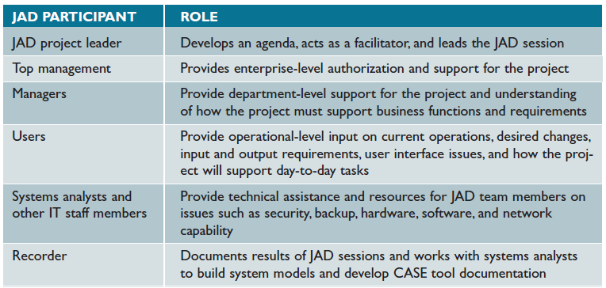
Team-Based Techniques (2 of 7)

Slide 39
Team-Based Techniques (3 of 7)
JAD advantages and disadvantages
Disadvantages
More expensive than traditional methods
Can be cumbersome if the group is too large
Advantages
Allows key users to participate effectively
Users are more likely to feel a sense of ownership
Produces a more accurate statement of system requirements, a better understanding of common goals, and a stronger commitment to the success of the new system

Slide 40
Team-Based Techniques (4 of 7)
Rapid application development
Uses a group approach like JAD
End product: new information system
Complete methodology
Includes a four-phase life cycle that parallels the traditional SDLC
Reduces cost and development time
Increases the probability of success
Relies on prototyping and user involvement

Slide 41
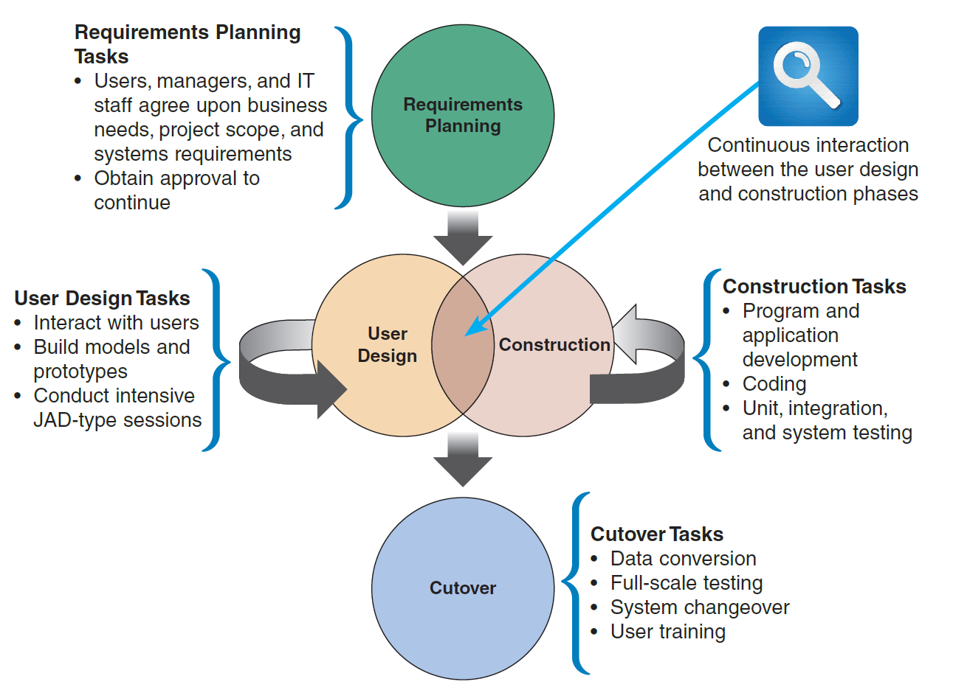
Team-Based Techniques (5 of 7)
The four phases of the RAD model are requirements planning, user design, construction, and cutover. Notice the continuous interaction between the user design and construction phases.

Slide 42
Team-Based Techniques (6 of 7)
RAD objectives
Cut development time and expense
Involve users in every phase of development
RAD advantages and disadvantages
Advantage
Helps develop systems quickly with cost savings
Disadvantages
Does not emphasize strategic business needs
Less time to develop quality, consistency, and design standards

Slide 43
Team-Based Techniques (7 of 7)
Agile methods
Attempt to develop a system incrementally by building a series of prototypes and adjusting them to user requirements
Developers revise, extend, and merge earlier versions into the final product
Emphasize continuous feedback
Each incremental step is affected by what was learned in the prior steps

Slide 44
Gathering Requirements In Agile Projects
Agile methods used for requirements gathering
Variation on interviews that focuses on features, user stories, scenarios, and storyboards is used
Requirements are gathered and successively refined

Slide 45
Team-Based Techniques (8 of 8)
Agile method advantages and disadvantages
Advantages
Very flexible and efficient in dealing with change
Frequent deliverables constantly validate the project and reduce risk
Disadvantages
Team members need a high level of technical and interpersonal skills
Lack of structure and documentation can introduce risk factors
May be subject to significant change in scope

Slide 46
Summary (1 of 2)
Systems analysis phase
Includes requirements modeling, data and process modeling, and consideration of development strategies
Objective is to understand the proposed project, ensure that it will support business requirements, and build a solid foundation for the systems design phase
Popular team-based approaches
JAD, RAD, and agile methods

Slide 47
Summary (2 of 2)
Requirements gathering process
Interviewing, document review, observation, questionnaires, sampling, and research
Systems analysts use various tools and techniques to represent system requirements
All requirements engineering activities can be helped through the judicious use of tools

Slide 48


